Slide 1

Requirements Elicitation
Notes:
‹#›

Slide 2
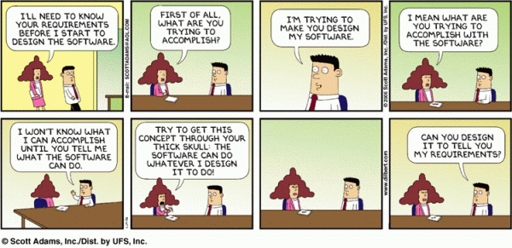
Overview
- What is “Elicitation”? - Who are the Players?
- Where is the Information? - Techniques for eliciting requirements
How do you organize and prioritize the information?

Slide 3
Requirements Elicitation
What is “Elicitation”?
From Webster’s online (my emphasis):
“Main Entry: elic·it Pronunciation: i-'li-s&t Function: transitive verb Etymology: Latin elicitus, past participle of elicere, from e- + lacere to allure 1 : to draw forth or bring out (something latent or potential) <hypnotism elicited his hidden fears> 2 : to call forth or draw out (as information or a response) <her remarks elicited cheers> “
Requirements Elicitation is the task of drawing out latent information. Make explicit that which is known.

Slide 4
Requirements Elicitation
Who are the players?
Before you charge in front of the customer, you need to know all the people involved in the process
Some are information sources, others stakeholders.
Sources:
Users – The ‘end-user” that will use your software. Note that this might be another system, so the representation may be the Chief Architect of that other system.
Buyers – This is the person responsible for acquiring your software and applying it to the target problem
- Note buyer != user in many cases!
Experts – “Outside” people who bring experience and/or domain expertise to bear on your problem domain
Consider getting an initial “wishlist” from each player so you understand where s/he is coming from

Slide 5

Information Sources
Where is the information?
People sources – “players” listed on previous slide
Documentation
Textbooks
Training materials (online or printed)
Reference works
Ad hoc conversation and experience – “osmosis”
The WWW
The “Google” effect
Discussion forums
How do you qualify and apply information from these sources?

Slide 6
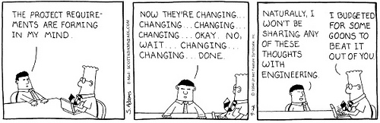
Requirements Elicitation Techniques
Techniques
Individual Interviews
Group Meetings
Storyboarding / Prototyping
Questionnaires
Observation / Ethnography / User-centered design
Perform research
Joint Application Development (JAD)

Slide 7
Interviews
Modality
2-way communication process
Participants may be with User, Buyer, or Expert
Structured versus Unstructured
How-to:
Set meeting expectations with interviewee a priori
Identify information targets to acquire
Meeting notes should be precise and undistilled
Do not pre-analyze up front
If possible, get interviewee signoff “for the record”
Time-sensitive: marathon sessions can lead to burnout and hasty decisions that become chains later
Get permission to record
Verify data with second sources or repeat interview

Slide 8

Interviews (cont)
Pros:
Richest form of information expression and capture
Get customer buy-in
Cons:
Time-intensive
Social tensions – burnout, personality conflict, control
Single-source of information
Does the interviewee have “sign-off” authority?

Slide 9
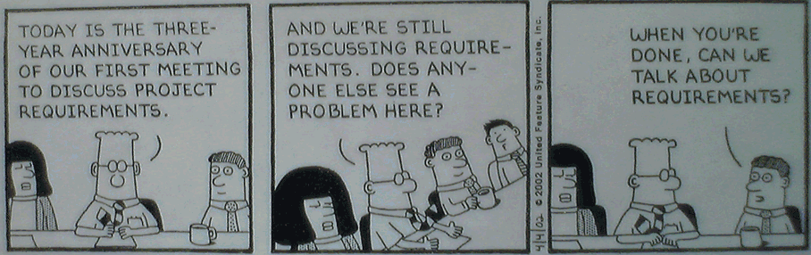
Group Meetings
Modality
2-way communication
Participants may be groups of customers, cross-functional teams, buyers, experts, focus groups, etc.
Typically “semi-structured”
Want structured activities to facilitate unstructured conversations!
The “workshop” concept vs. the “brainstorming” concept
May be facilitated by groupware
How-to:
Set your expectations and targets ahead as before
Scheduling: Can you get undisturbed time?
Decide on the level of structure
Leave brainstorming sessions open for discovery
Plan the semi-structured tasks for “workshops”

Slide 10
Group Meetings
How-to (cont):
Plan the meeting environment
Break-out rooms
Collaborative tools
Information capture tools
Distribute meeting notes as before
Consider assigning action items (if possible)
Consider establishing smaller followups – online tools?
Pros:
Groups can be self-reinforcing, build consensus
“Real-time” requirements validation
Cons:
More complex to schedule and administer
Social dynamics – who controls the meeting

Slide 11
Storyboarding / Prototypes
Modality:
2-way
Participants are end users
Provides a structure for individual or group interaction
Storyboarding more conducive to small group interaction
How-to:
Develop functionality based on vague requirements
Throw-away code!
Present to end user for direct feedback
Robustness of prototype needs only to be “sufficient to facilitate effective user feedback”
Technology base is chosen based on RAD, not based on the non-functional requirements

Slide 12
Storyboarding / Prototypes
Pros:
Making the solution “visible” provides you a precise means of agreeing on things with the user
May also facilitate your design and test cases
Cons:
Cost to develop (need a RAD framework)
May pigeon-hole user into early requirements commitments
May pigeon-hole developers into early design commitments
Throw-away solution becomes a BBOM

Slide 13
Questionnaires
Modality
1-way communication
May be anonymous
Technology-assisted
How-to:
Determine your distribution list
Use careful vocabulary
Validate questions and answers – try not to show bias
Repeat questions to ensure consistency
Ensure results are quantifiable
One of the benefits is using technology to reach a large group of stakeholders, so be sure you can aggregate results

Slide 14
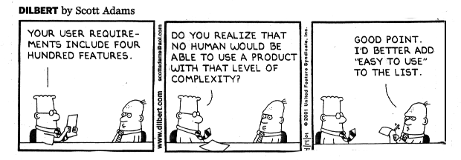
Questionnaires
Pros:
Ability to reach a lot of stakeholders
Objective, Quantifiable results
Broad topic coverage
Relatively fast
Anonymity
Cons
Ambiguity in questions
Long time to design
Poor response rates
Restricted (rigidly structured) feedback
Lesson: Do not use in isolation, confirm data with secondary methods

Slide 15
Perform Research
Modality
“0-way” communication
Guidance?
How-to:
Identify appropriate information sources
Market surveys
Industry studies – association groups, market research, technical standards organizations, research community
Be wary of the “Google factor”
Get expert guidance!
Research as a team for common understanding
Create a taxonomy of the technical and market space
Attempt to get feedback on your understanding
Learn the user/customer vocabulary and enhance communication, not necessarily derive requirements!

Slide 16
Perform Research
Pros:
0-way means it can be planned and executed individually (or in small teams)
Understanding current practices facilitates other techniques
Cons:
May build a bias toward one solution space
You are not supposed to write your own requirements!
Ability to assess the proper or best sources
Time to tackle the learning curve
Again, goal is to learn enough to facilitate communication using one of the other methods, not to write your own requirements!

Slide 17
Observation
Also called “ethnography”
Modality:
1-way communication
Real-time vs. video capture vs. event capture
Staged environment versus real environment
How-to:
Determine modality – will you observe live or capture via video or some other technology
Review organizational & regulatory policies, NDAs, etc.
Prepare a debriefing memo
Determine a recording format and method
Embed into environment with minimal intrusion

Slide 18
Observation
Pros:
Observing how customer works allows you to see how the technology benefits.
Removes the 0th-order interpreter – the user
Cons:
Time-consuming
Observee will not behave “naturally” (Hawthorne effect)
Disruption to the workplace
To Note:
Ethnography is a well-known elicitation technique in research circles, and may be suitable for inception
Requirements elicitation using ethnography is often too time-consuming, too disruptive – simply too awkward

Slide 19
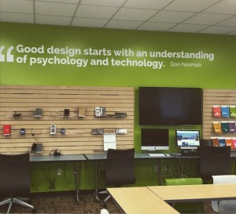

Observation
To Note (cont):
A variant on embedded observation is a
staged observation for HCI evaluation
Observe a user interacting with the system
Video
Event tracking (mouse clicks, screen visit sequence, etc.)
Not really “ethnography”
Part of “User-centered design” when designing a HCI
Another variant on Observation is Apprenticing
The users train the Business Analyst on how to do the job
BA then performs in that role for some time to learn first-hand the issues for end users
Time-consuming but very effective

Slide 20
Joint Application Design
Modality
Multi-way: customers, users, designers, and experts
A cross between group meetings and prototypes
Similar to evolutionary style of concurrent development, except the stakeholders are part of the development team
How-to:
Carefully assemble a team
Ensure roles are blurred – everyone is a peer and everyone’s opinions are important. Design is not just for the designers
JAD sessions require a clear statement of the purpose of the session and its goals.
JAD sessions are usually run by a facilitator who keeps the participants focused.
Can have observers, but observers must remain silent according to the rules of JAD.

Slide 21

Joint Application Design
Pros:
Workshop-type feel facilitates participation
All stakeholders feel ownership and teamwork
All concerns laid out on the table
Cons:
Requires a skilled facilitator
Social issues – some individuals may dominate
Consensus building can be difficult in a large group

Slide 22
Elicitation Issues
“Yes, but…”
Issue: Software is “Infinitely malleable”, so users continue to add/morph features. A scope issue!
Solution: Make the software “real” (prototype).
“Undiscovered Ruins”
Issue: “the more you find the more that remain”
Solution: Iterate!
“User and Developer”
Issue: Communication gap between the two
Solution: Burden is on the solution provider! Use multiple techniques, reviews, and checks.
“Over-reliance on Interviews”
Issue: Interviews the most obvious thing to do
Solution: Employ the full range of techniques here, and have a plan and internal retrospectives of how elicitation is doing on your project.
These ideas from Leffingwell & Widrig, but you should also read the 2003
Hickey & Davis paper “Elicitation Technique Selection: How Do Experts Do It?” and at least
the intro of Carrizo et. al. 2014 “Systematizing requirements elicitation technique selection”

Slide 23
Requirements Elicitation Summary
Elicitation and the Requirements Workflow
Your deliverable is “uncovered” knowledge
Format may or may not be important
We are assuming not important yet. Natural language is fine
The responsibility of the BA
Next steps involve documenting, organizing, prioritizing requirements
Reminders:
This is a “soft science” – there is no recipe for success
Iterate with the customer until you get convergence
Cross-check results with multiple people and methods
Understand what is volatile and what is enduring early!
Do not burn the customer out! Do not burn yourself out!
Do not over-commit or ask the customer to over-commit!

